Slide 1
IMSSC January 2020

Slide 2
Next Release
Release Date: Monday 26th Mar 2020
Code freeze: 21st Feb
Beta test: 26th Feb - 10th Mar
Deploy to ISIS Yum Repo: 30 Mar
Still Includes:
Mantid Workbench
Mantidplot

Slide 3
Mantid Workbench
Ready for use
Interfaces
SANS v2
mSlice
Reflectometry
Muon
Indirect
All algorithms, scripts, workflows
1D plotting, Colour maps
3D plotting via scripts
Fitting
Slice / Spectrum Viewer
Script and iPython window
Instrument View
Project save/load/recovery
Workspace History
Sample Logs
Script Repository
Future versions
Interfaces
Engin-X
Sliceviewer extensions
Non orthogonal axes
Any Orientation slices
Extracting slices to another workspace
Peaks Display
3D plotting via GUI
Icat interface
VSI

Slide 4
Mantid Team structure

Slide 5
ISIS Development Team
Nick Draper (PM)
Key:
Staff or Tessella
Vacancy (Core)
Gemma Guest (LSS)
Danny Hindson (Diffraction)
Anthony Lim (Spectroscopy)
Internal Transfer planned
Daniel Murphy (Support)
David Fairbrother
Harriet Brown
Matthew Andrew
Graduate
Alice Russell
Gio Di Sienna
Connor Finn
Stephen Smith
Student
Student
Phil Colebrooke
Richard Waite
Temporary
Vacancy
Or Empty
Dimitar Tasev (Imaging)
Martyn Gigg

Slide 6
Questions?
NTC March 2020 - Mantid plot or workbench?
Beta testing, in or out of cycle?
Is everyone ready for Python 3?
When are the Groups User meetings? Should Mantid present a poster
Next Mantid User Meeting? Where? Topics?
Mantid Review?

Slide 7
Progress since last SSC

Slide 8
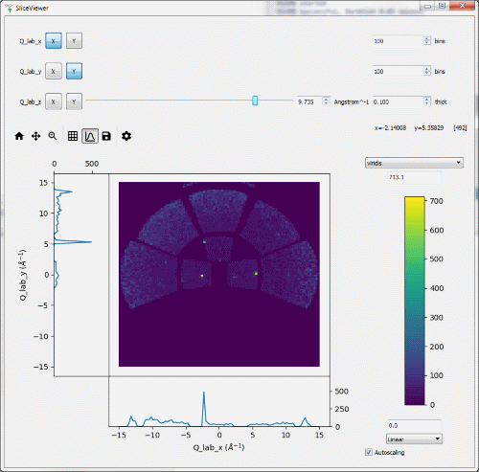
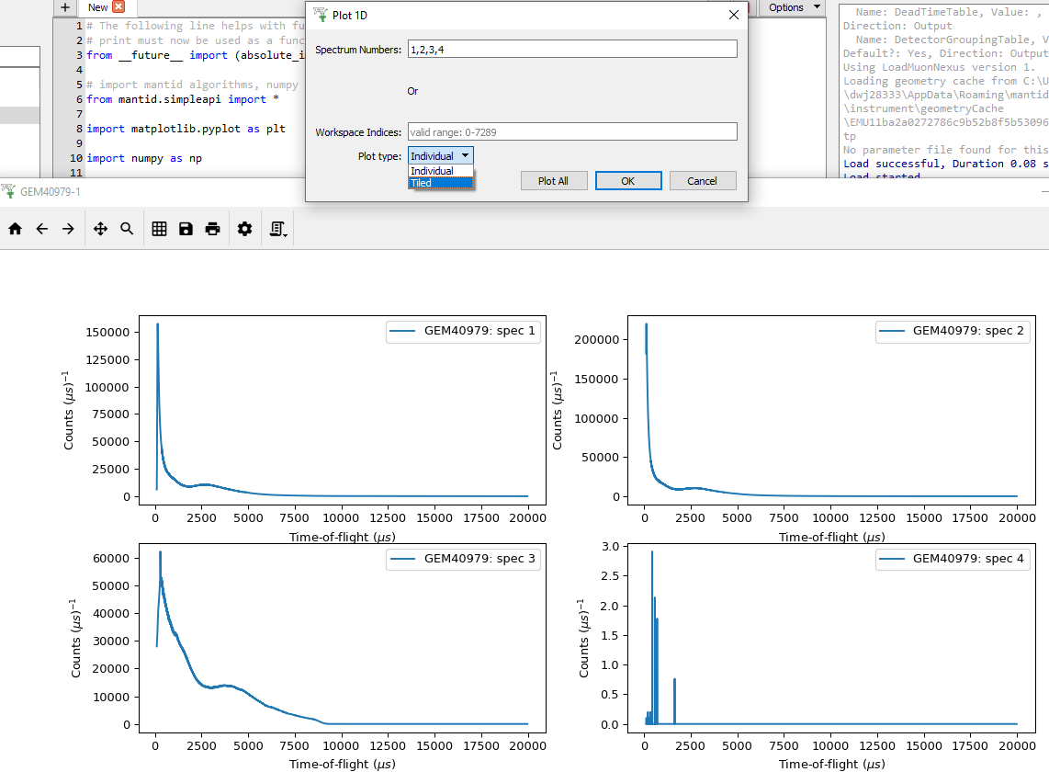
Core
Workbench
All remaining user interfaces
Initial Sliceviewer inc. Spectrumviewer
Plotting
Options and formatting
Plot scripting to python
improved usability, context menus etc
Plot windows stay on top for drag and drop
2D plot normalisation
Tiled plots

Slide 9
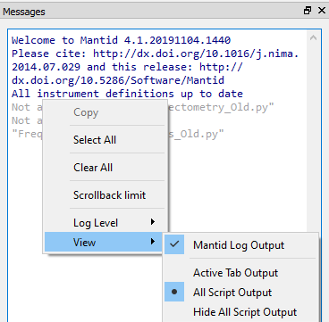
Core
Workbench
Script repository
Fit workspaces available from the window
Show Detectors
Scripting
Improved auto completion
Output filtering by tab
Better control of text zooming
Project saving
Warning on saving large projects
No longer freezes on large projects
Lots of bug fixes

Slide 10

Core
Mantidplot
Bug fixes only
Framework
Support for Python 3
Updates for several OS’s
Support for nGEM detector
Improved startup resiliency
Many, many algorithm improvements

Slide 11
Core Future
Workbench
Implement remaining functionality
Sliceviewer extensions
Non orthogonal axes
Any Orientation slices
Extracting slices to another workspace
Peaks Display
Advanced plotting
Full support of settings
Mantidplot
Migrate users and remove

Slide 12
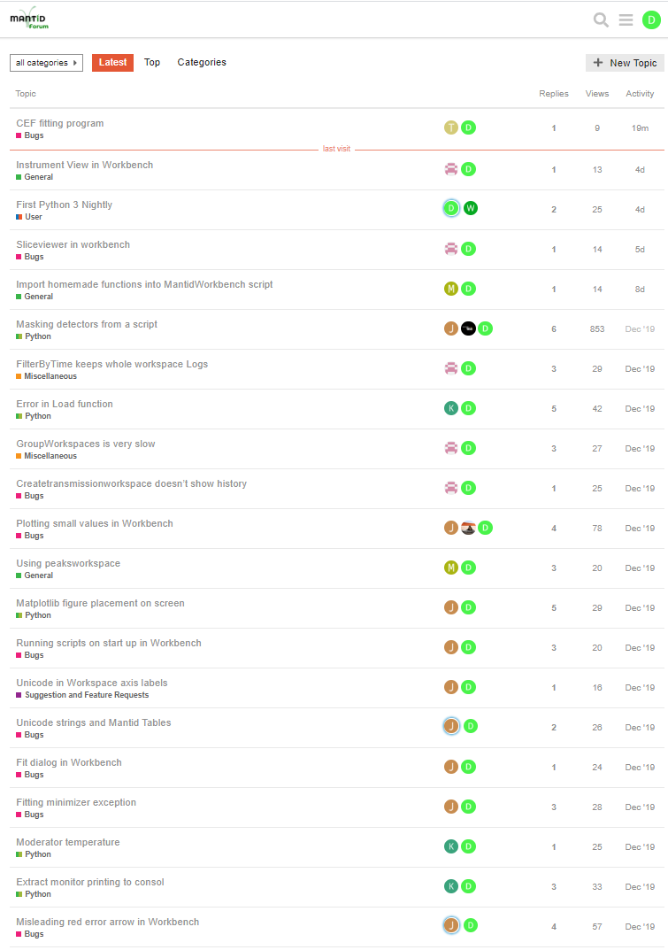
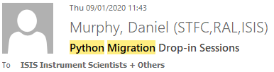
Support
Reply to questions / reports
via Forum, Help emails
Time to engage
Providing info. or workaround
Raising an issue
Improved response time!
Python 3 Migration
Tools and Timescales
Drop-in sessions

Slide 13
Support Future
Improve Error Reporter
fix anonymous problems
Update Tutorials for Workbench
Engage with more Scientists
see how Mantid is used
understand priority
Quality Assurance improvements
Testing our tests
Track progress of error reports/ issues raised during testing ?

Slide 14
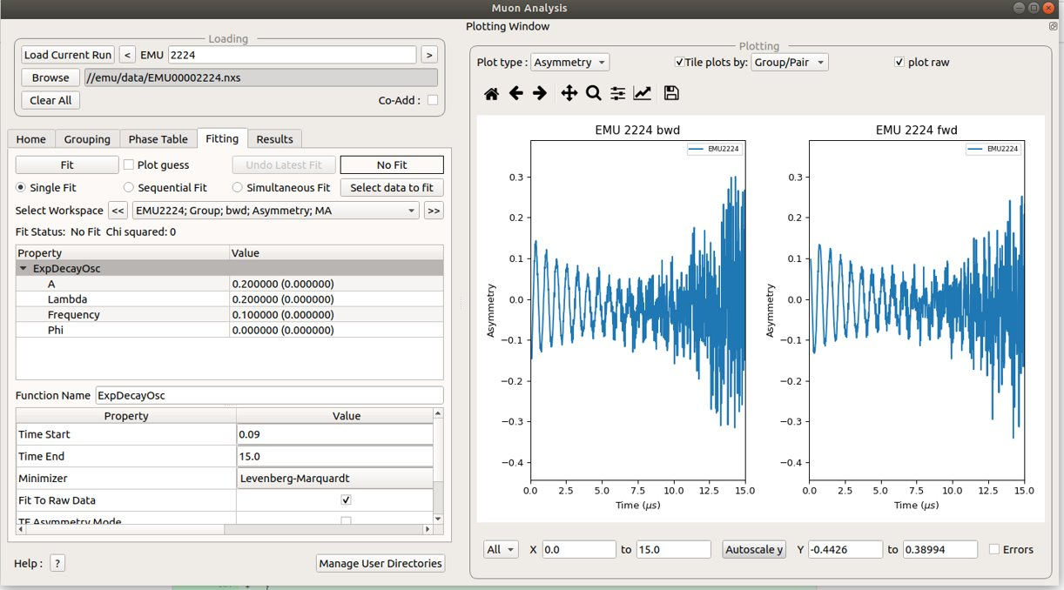
Spectroscopy
All GUI’s have been added to workbench
New moun analysis interface
Improved plotting in QENS GUI

Slide 15
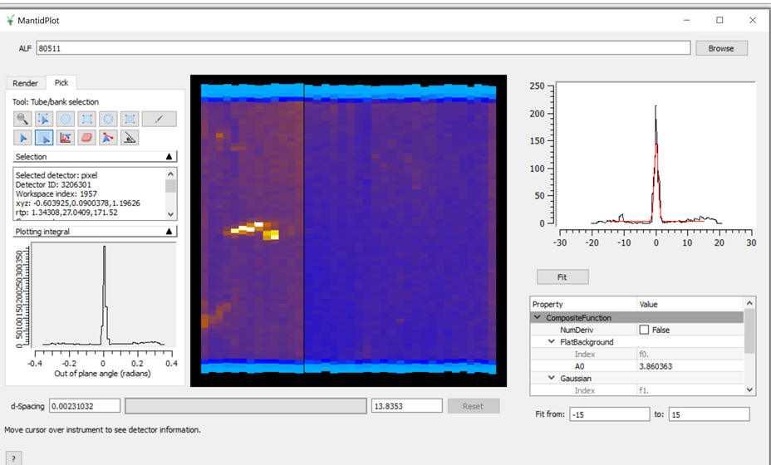
Spectroscopy
Added Indirect settings
ALF View has been added
Muon fitting functions have been split up

Slide 16
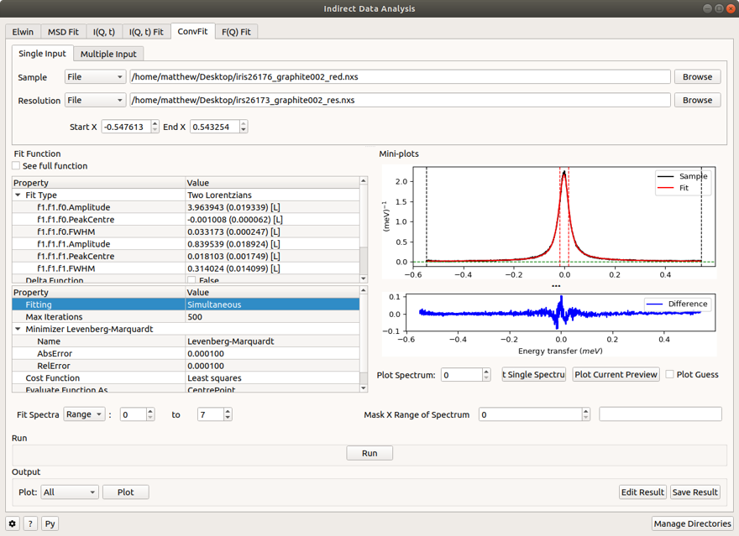
Spectroscopy
QENS has simultaneous fitting for two tabs

Slide 17
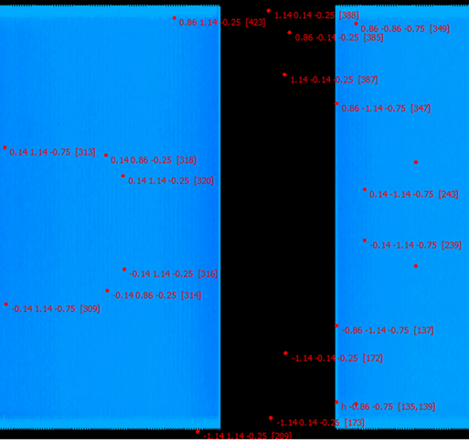
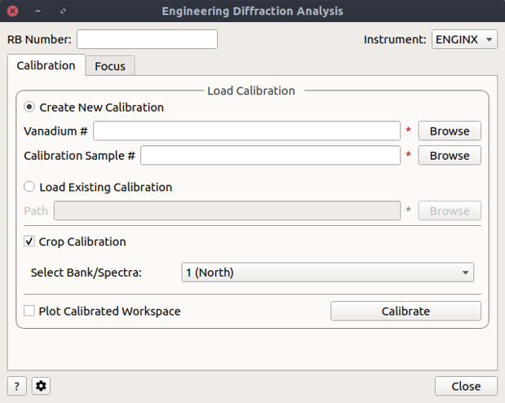
Diffraction
Single Crystal
New algorithms for predicting and indexing peaks in modulated structures
Constrained UB by lattice type eg tetragonal
Improvements in file interchange formats
Generalising integration algorithms to work with non-event data (ongoing)
Engineering (Sept 2019-)
Migration (and simplification) of Engineering UI from MantidPlot to Workbench
PredictFractionalPeaks works for peaks off the detector

Slide 18
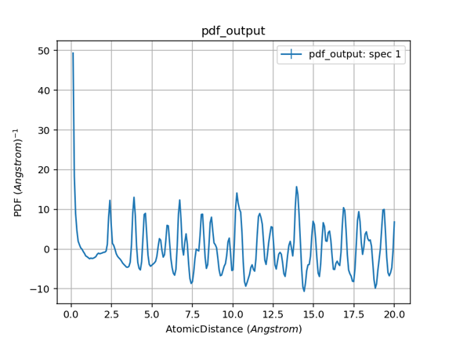
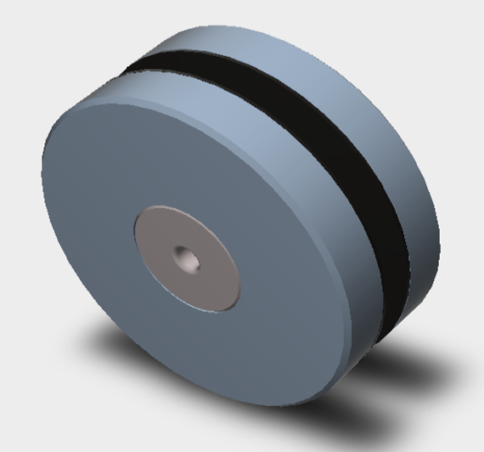
Diffraction
Powder Diffraction
Miscellaneous improvements
HRPD in active use
Total Scattering pdf generation in Polaris scripts
Script to generate Placzek self scattering correction
Absorption Corrections
Support for complex environment shapes in Monte Carlo
Testing with Pearl at the moment
CAD representation of Pearl environment

Slide 19
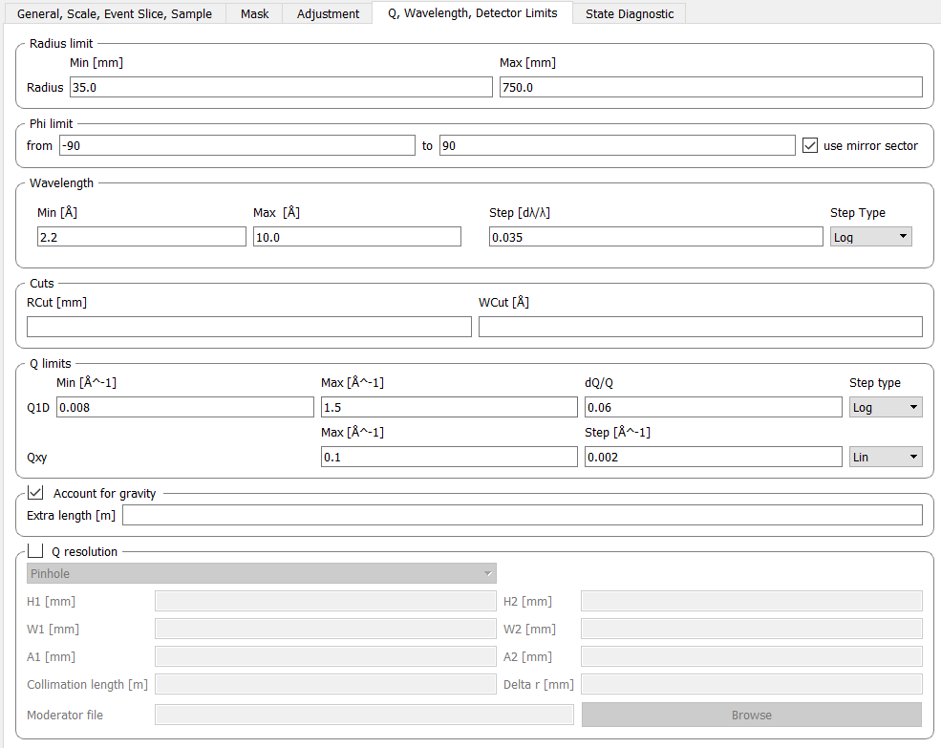
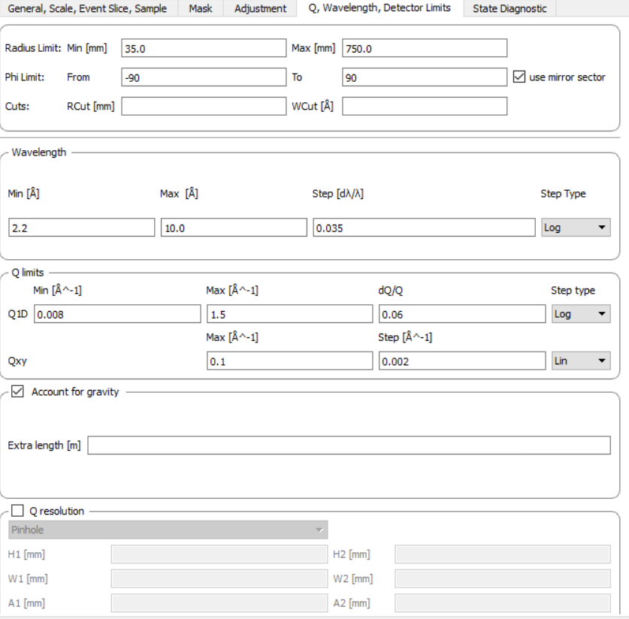
SANS
Numerous Usability Fixes
(Avoid triple-clicking cells, cancel keeps selection, UI cleanup...etc.)
Increased Performance
~35% faster processing in 4.2 and up to ~40% faster batches in 4.3
Zoom Monitor 5 Shifting
Top level history working
Old Q Settings Tab
Updated Q Settings Tab

Slide 20
SANS
Future Work
Support for TOML User Files
Multiple scattering checks
Integrate Richard’s updated tube calibration scripts
Ongoing usability improvements

Slide 21
Reflectometry
4.2
Full GUI state included in Project Save
Manually save/load a batch of settings
Generate a recovery script (Workbench only)
Many stability fixes and tests
4.3
System tests for new workflow algorithms
Fixes to workspace history
Options dialog re-added

Slide 22
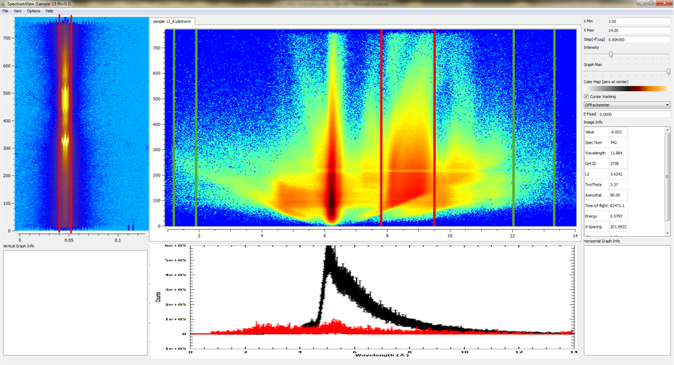

Reflectometry Priorities 2020
1. SliceViewer or similar according to our previous specs
2. Background subtraction option in the GUI (“Experiment settings” tab?).
Ideally make table into tree and add per angle background region (as list (of lists)).
3. Correct detector pixel positions (algorithm - ApplyCalibration?)
4. Generate polarisation corrections (algorithm)
5. Stitch option for interlacing
6. Q error bars (λ error bar propagation)
7. Realistic beam path (e.g. additional reflection) - IDF change?

Slide 23
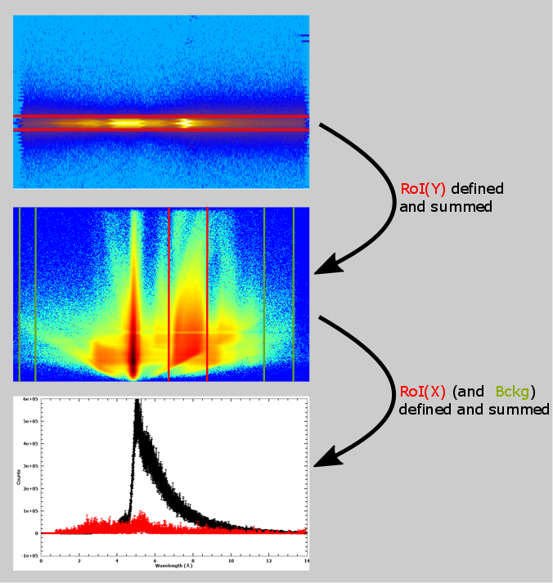
Workflow
A tool which allows the following workflow
Define RoI in one direction
Show integrated projection in other and ToF
Define RoI and RoB (possible a mask too?)
Show integrated projections of RoI and RoB if defined

Slide 24
Options (Spectrum Viewer Style)

Slide 25
Imaging work plan 2020
Tasks | Comments
Priority:
Further develop GUI / process list for reconstruction with SAVU backend | reconstruction for white beam spectrum includes Tomopy/ Astra with all options for FBP and iterative reconstructions; Either locally or on cluster / iDaaaS
Later:
Reconstruction of 4D data sets, i.e. for multiple sub-wavelength ranges / multi-channel data | Reconstruct 4D (3D+wavelength) data volumes; Visualisation is a challenge Develop NXS-tomo format
Gather requirements for Bragg edge analysis | See what other codes do well/ not well

